Slide 1


MET CS 665 Software Design and Patters Class Project: ServeMuse
Michael Kramer
mgkramer@bu.edu
U-17187772

Slide 2


What is ServeMuse?
A Design to Automate Mission Creation and Delegation for The United States Army Band “Pershing’s Own”
Flexible, Reusable and Sufficient System for mission processing potentially applicable
For other military bands
For other non-musical military units
For civilian music contractors
Any corporate tasking potentially…

Slide 3


ServeMuse is based on Mission Processing at The United States Army Band, “Pershing’s Own” (TUSAB)
TUSAB is comprised of various elements
The musical ensembles:
The Army Blues (shown in photo)
Downrange
The Strolling Strings
The Ceremonial Band (including the Herald Trumpets featured in inaugural events etc.)
More…
The Support Element:
Public Affairs
Tech
Transportation
HR
Operations

Slide 4
How to use: Overview
SeniorProducer class compiles job details into a Google Calendar Event
Need to add dependency to pom to use Google Calendar Event
groupID: com.google.apis
artifactId: google-api-services-calendar
Version: v3-rev260-1.23.0
Event is passed into a Request Object

Slide 5
How to use: Overview Continued…
Request is passed into Operations.submitRequest()
Request now has a Status (i.e. State) of SubmittedStatus
Operations.delegate()
Returns an ElementProducer but first:
Sets the appropriate Delegator Object
Creates the appropriate JobFactory
Calls the appropriate ElementProducer (object to be returned)
Uses the Delegator object to bind the JobFactory and request
Adds the delegated job to the ElementProducers calendar vector before returning the object

Slide 6
How to use: Overview Continued…
ElementProducer maintains a vector of all Jobs delegated to their Element
ElementProducer can access a Job through .findJobInCalendar()
.findJobInCalendar() is uniquely implemented according to the preferences of the ElementProducer
ElementProducer call distribute() whenever appropriate according to the flow of the ensemble
The distribute method creates deliverables associated with Job according to Job type
The distribute method also uses rosters to Instantiate the personnel to receive deliverables
Deliverables are publishers and personnel types are subscribers

Slide 7
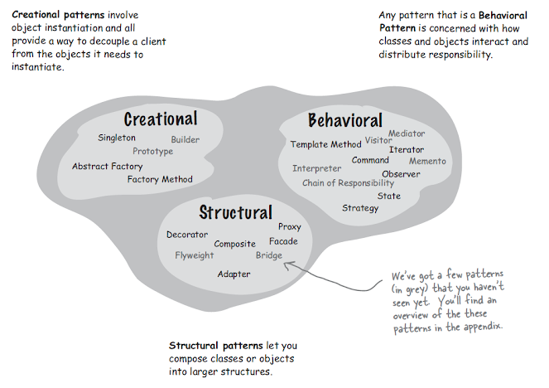
Design Patterns Utilized

Slide 8
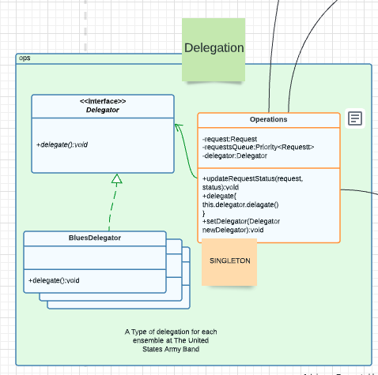
Delegation: Not Covered in Lecture

Slide 9
Delegation Continued…
Operations HAS-A Delegator
Delegator is an Interface with an abstract delegate() method that returns a Job
Concrete implementations of Delegator are passed subtype delegators and return subtype Jobs

Slide 10
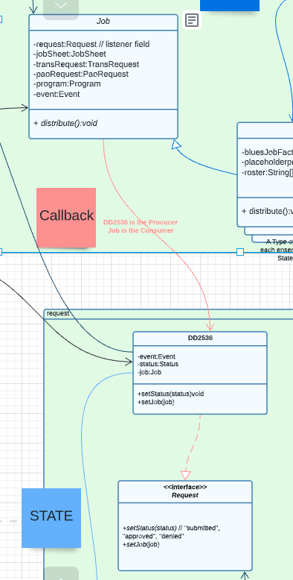
Callback

Slide 11
Callback Continued…
Request is the Producer
Request HAS-A Job and HAS-A Status
Job is the Consumer
Job.distribute() creates deliverables associated with job which have a subscriber base interested in the Status of a job – namely the JobSheet
Request.setStatus() produces the Status for the Job to consume synchronously
Operations.updateRequestStatus() sets up Producer and Consumer with a new Status for Synchronous distribution through ElementProducer

Slide 12
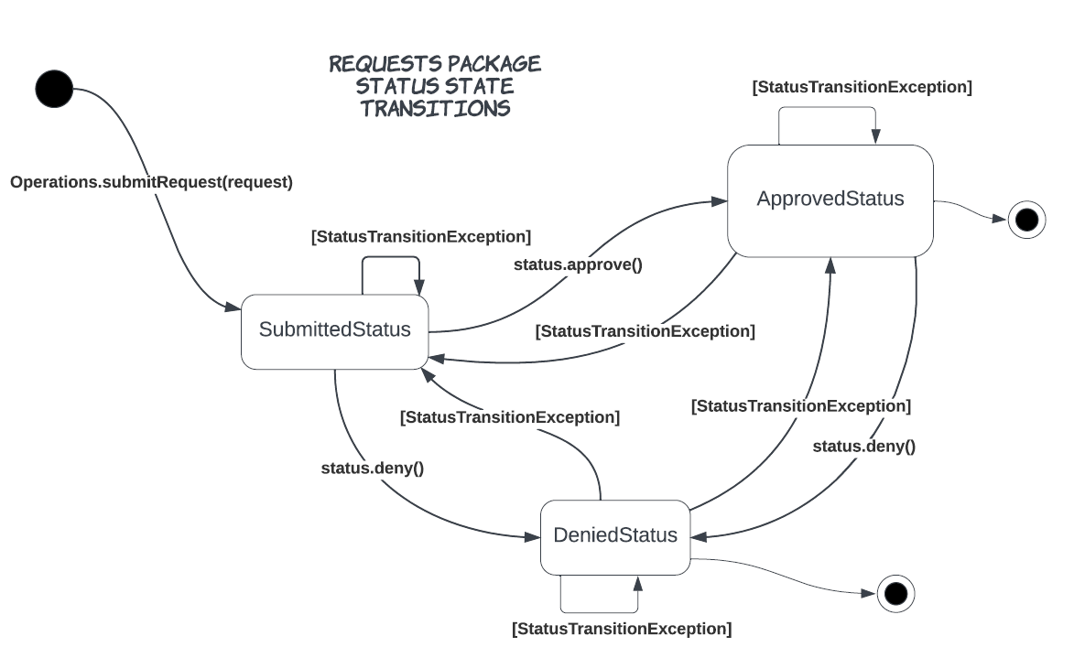
State Pattern State Transitions

Slide 13
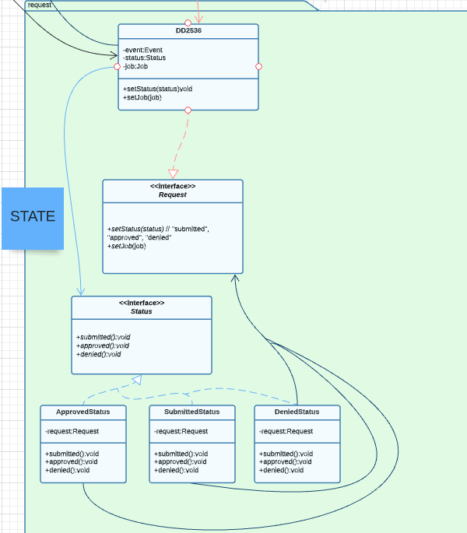
State Pattern Class Diagram

Slide 14
State Pattern Cont…
A Request (Dd2536 Class) HAS-A Status
Current Usage:
Request.setStatus() setter rather than Status Interface methods

Slide 15
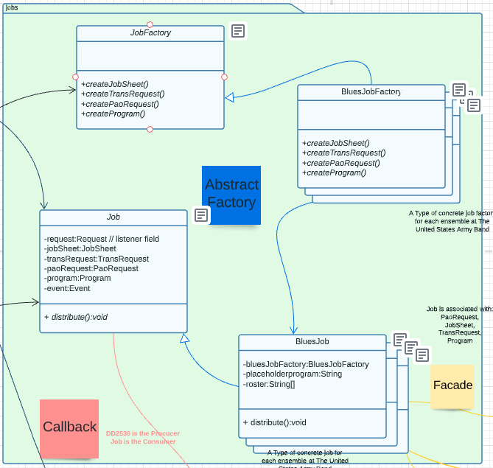
Abstract Factory

Slide 16
Abstract Factory
Abstract Factory Class: JobFactory
Abstract Product Class: Job
Concrete Factories: BluesJobFactory, DownrangeJobFactory etc.
Concrete Jobs: BluesJob, DownrangeJob etc.

Slide 17
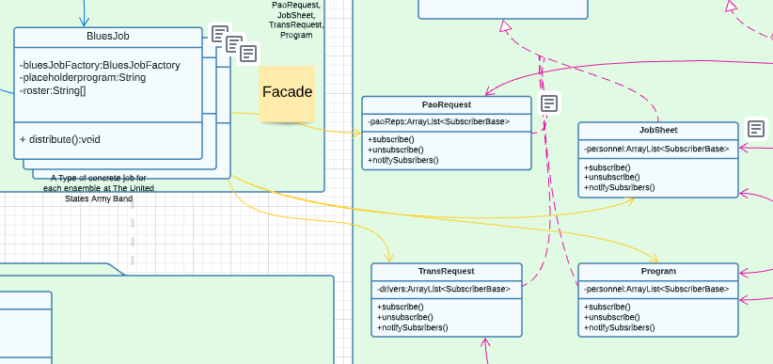
Facade

Slide 18
Façade Cont…
Job.distribute() is the simple interface to the complex subsystem of the deliverables package.

Slide 19
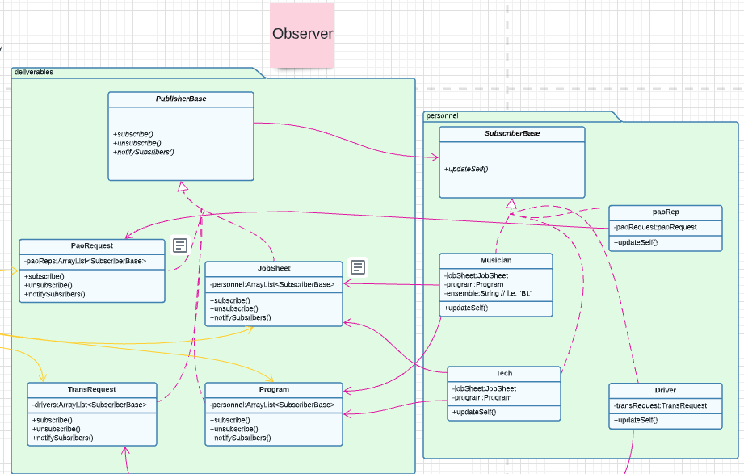
Observer

Slide 20

Observer Cont…
Deliverables package classes are PublisherBase implementers
Personnel package classes are deliverables.SubscriberBase implementers

